Slide 1


Play with data – JAVA Collection framework
Sarower Ahmmed

Slide 2
collections framework
The Java collections framework (JCF) is a set of
classes and
interfaces
that implement commonly reusable collection data structures.

Slide 3
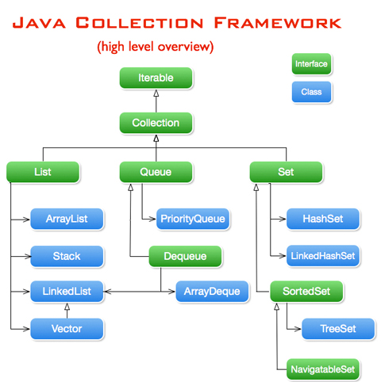

Slide 4
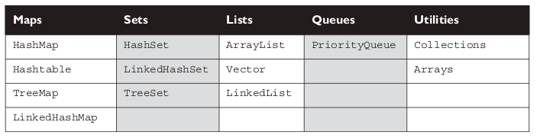
In short classification

Slide 5
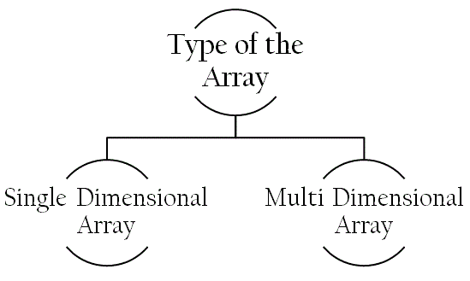

Slide 6
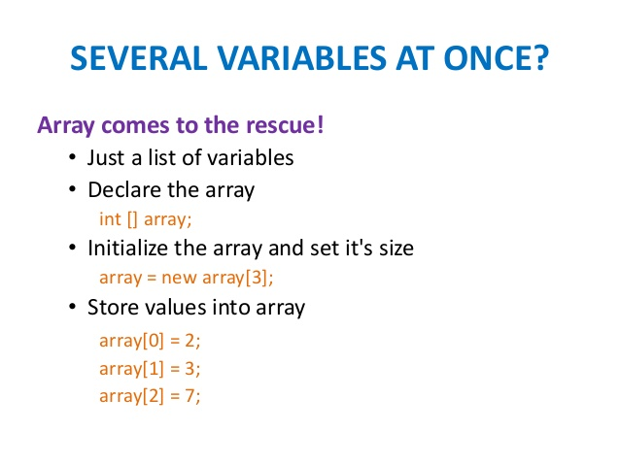

Slide 7
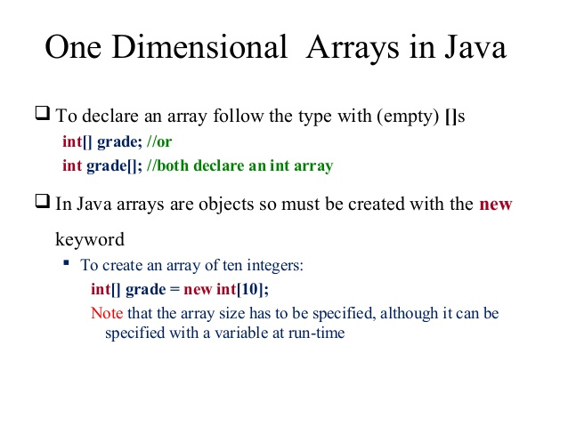

Slide 8
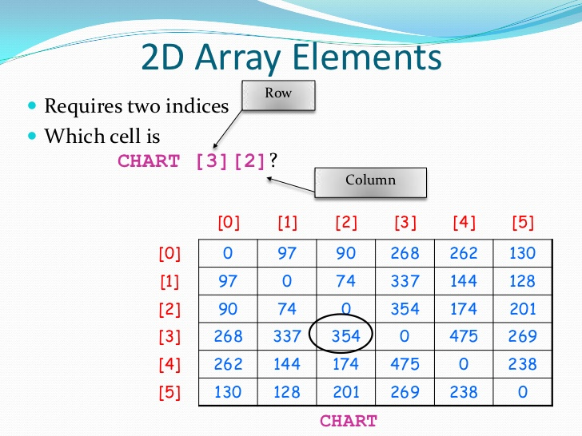

Slide 9
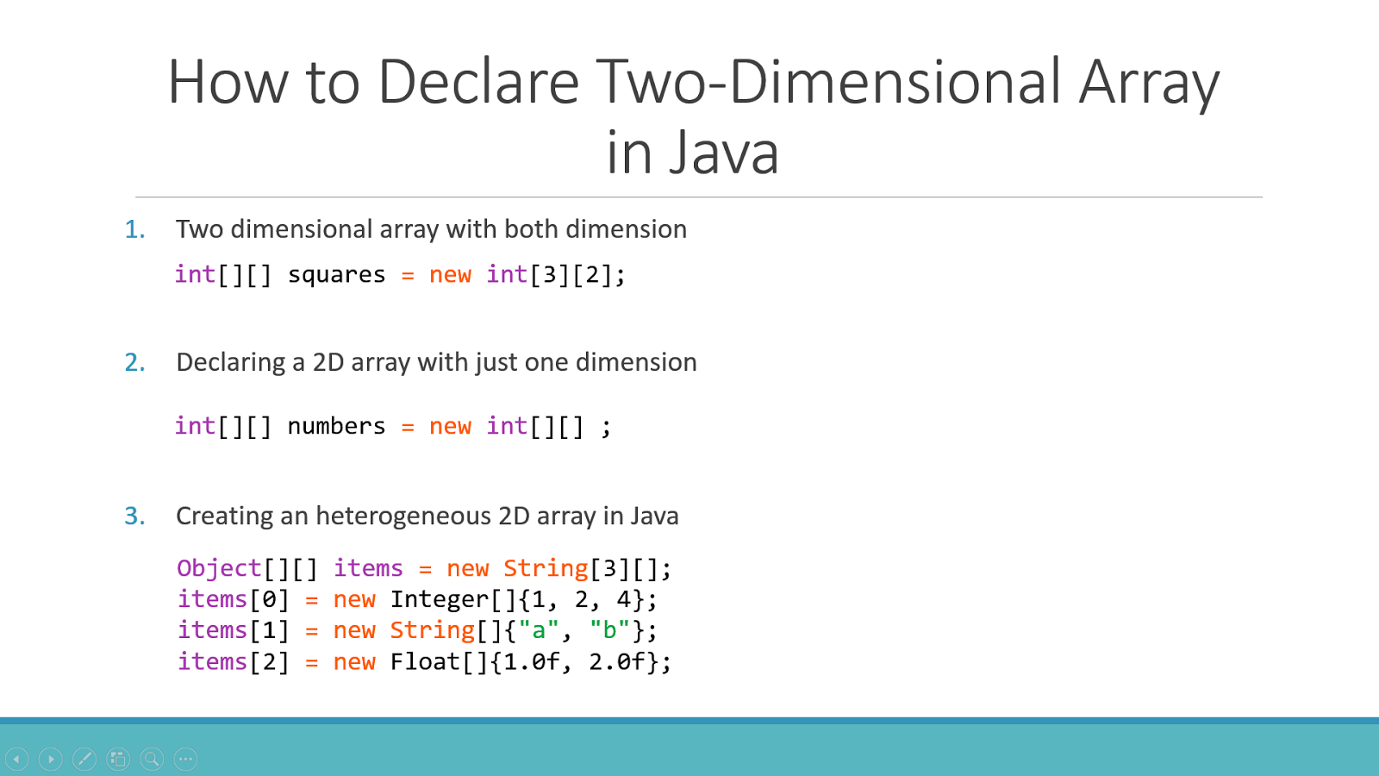
This part is important

Slide 10
Single vs two dimensional Array
Integer addarrayobject[] = new Integer[3]; addarrayobject[0]= new Integer(4)
addarrayobject[1]= new Integer(7)
addarrayobject[2]= new Integer(9)
Integer addarrayobject[][] = new Integer[3][2];

Slide 11
Java Looping
To find specific value from collection –need looping through all value
Loop option in java:
For loop
Advance for loop
While loop
Do while
Iterator

Slide 12
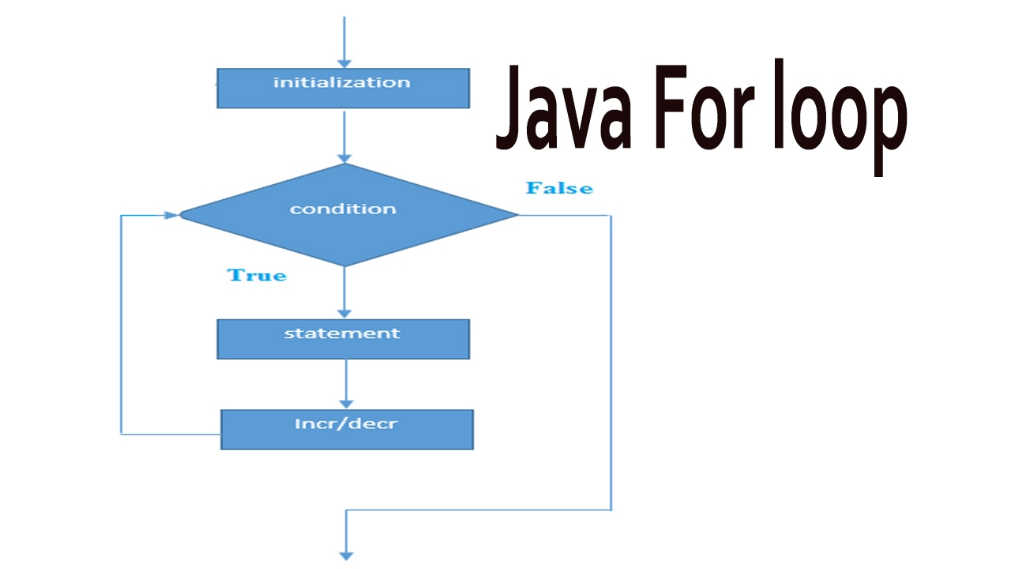

Slide 13
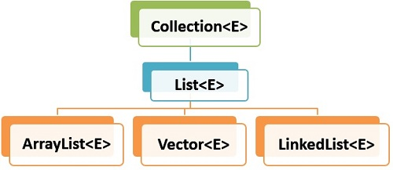
E= data type

Slide 14
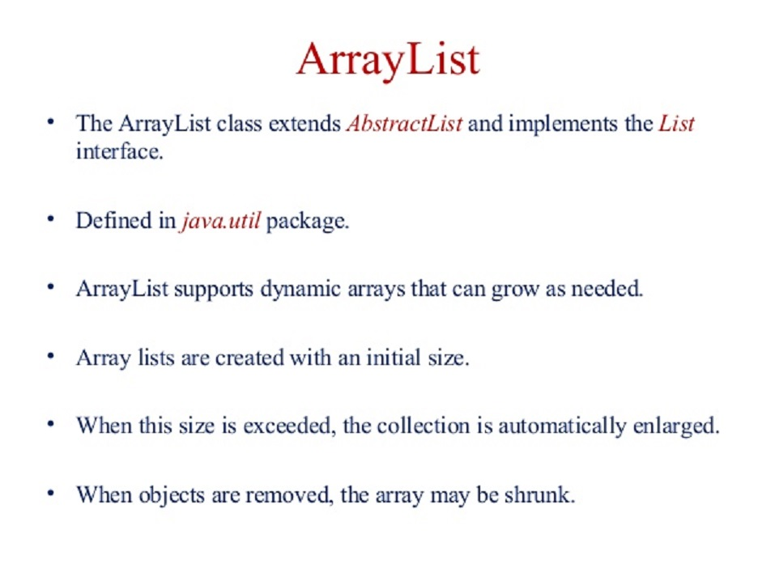

Slide 15
How to know total size or Number
Array use – obj.lenth() to count total array size but
ArrayList use- obj.size()
How to add value in arrayList or list?
Obj.add(value)
How to get value after loop from array or List?
Array – obj[index of loop]
ArrayList or List- obj.get(index of loop)

Slide 16
Array with loop
String[] arrayobj = new String[3];
arrayobj[0]= "Love yourself";
arrayobj[1]= "Alive is awesome";
arrayobj[2]= "Be in Present";
for(int i=0; i < arrayobj.length ;i++){
System.out.print(arrayobj[i] + " ");
}

Slide 17
ArrayList with looping
ArrayList<String> arrlistobj = new ArrayList<String>();
arrlistobj.add("Alive is awesome");
arrlistobj.add("Love yourself");
arrlistobj.add(“hi");
for(int i=0; i<arrlistobj.size();i++){
System.out.print(arrlistobj.get(i).toString());
}

Slide 18
Advance for loop
ArrayList<String> arrlistobj = new ArrayList<String>();
arrlistobj.add("Alive is awesome");
arrlistobj.add("Love yourself");
for (String a: arrlistobj){
System.out.println(a);

Slide 19
Array List with while loop
ArrayList<String> arrlistobj = new ArrayList<String>();
arrlistobj.add("Alive is awesome");
arrlistobj.add("Love yourself");
Iterator it = arrlistobj.iterator();
System.out.print("ArrayList object output :“+ it);
while(it.hasNext())
System.out.print(it.next() + " ");

Slide 20
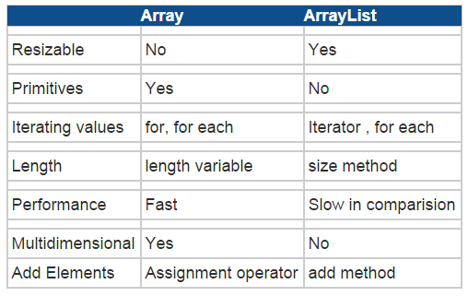

Slide 21
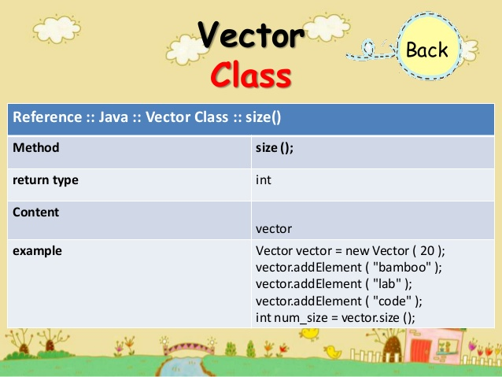

Slide 22
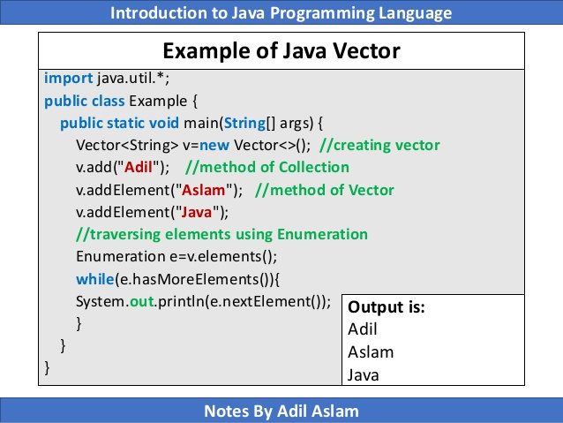

Slide 23
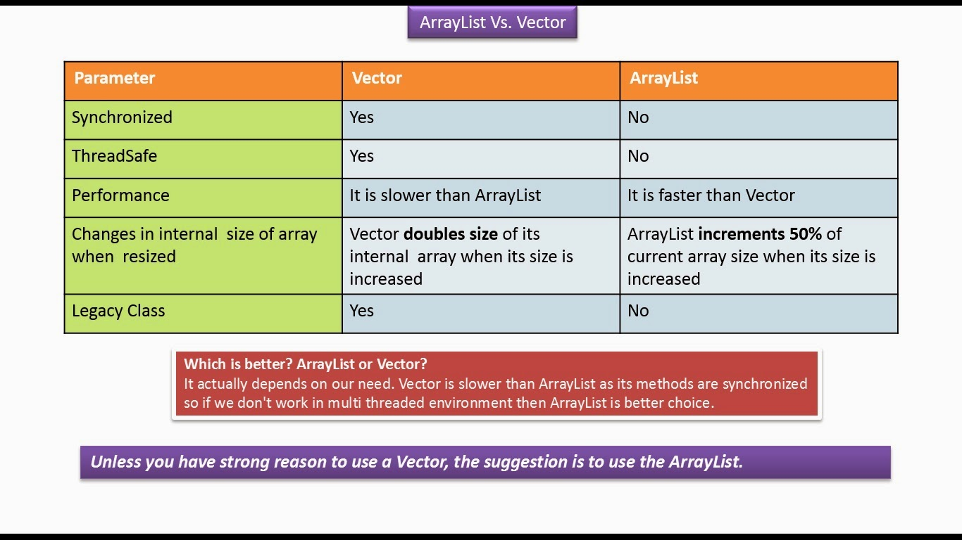

Slide 24
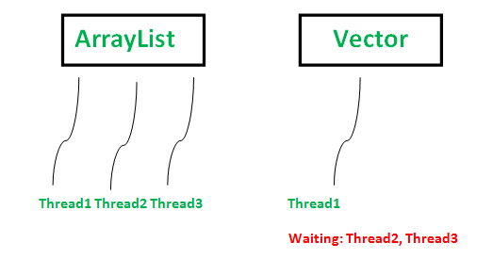
Synchronization:
ArrayList is non-synchronized which means multiple threads can not work on ArrayList at the same time.
Vector is synchronized. This means if one thread is working on Vector, no other thread can get a hold of it. Unlike ArrayList, only one thread can perform an operation on vector at a time.

Slide 25
Which collection class you use in your work or current project?
Array
ArrayList
Sometime Hashmap/ map

Slide 26
Why you use those?
Array
ArrayList
Sometime Hashmap

Slide 27
Is those thread safe or can use for multithread environment?
Array
ArrayList
Sometime Hashmap
Answer ==➔Not Thread safe and not synchronized

Slide 28
Which one thread safe or can use for multithread environment?
Vector
HashTable

Slide 29
How to use Arraylist or list in multi thread environment
Use list or arrayList for 1st thread
Than clear the list
Obj.clear()
Reuse same array list for next thread

Slide 30
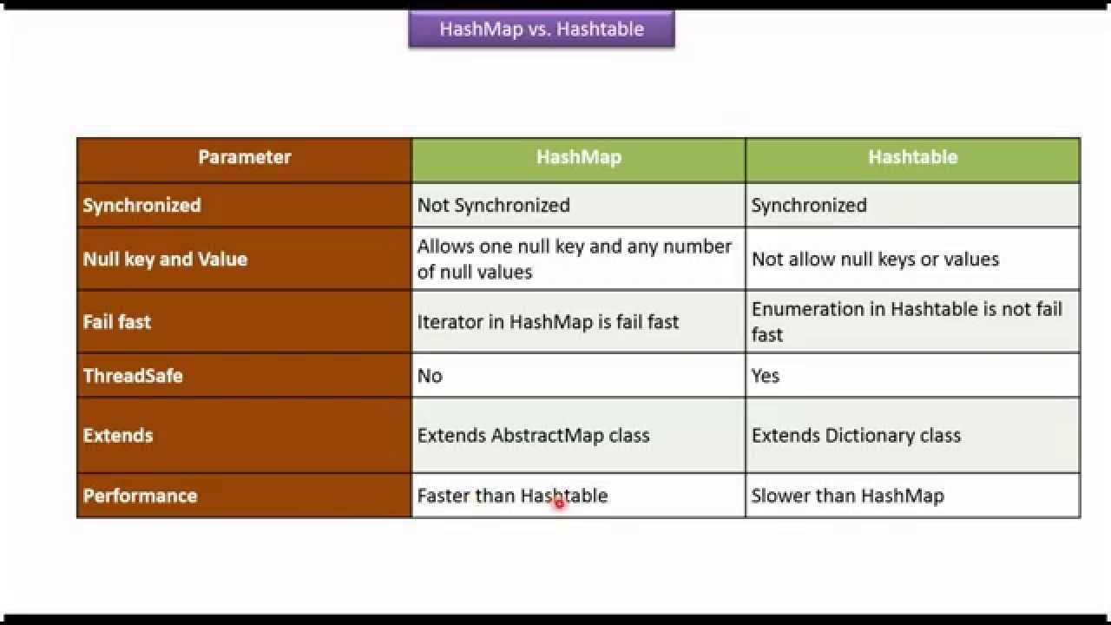

Slide 31
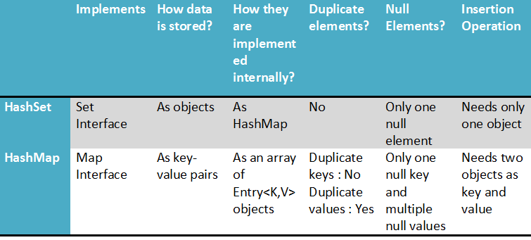

Slide 32
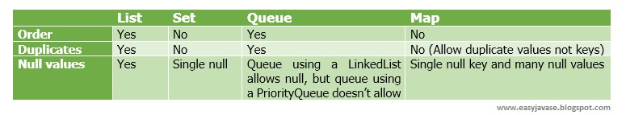
For interview

Slide 33
More slides after Thanks slide, if you want to learn more

Slide 34

Thanks

Slide 35
Java Collections class
Java collection class is used exclusively with static methods that operate on or return collections. It inherits Object class.
The important points about Java Collections class are:
Java Collection class supports the polymorphic algorithms that operate on collections.
Java Collection class throws a NullPointerException if the collections or class objects provided to them are null.

Slide 36
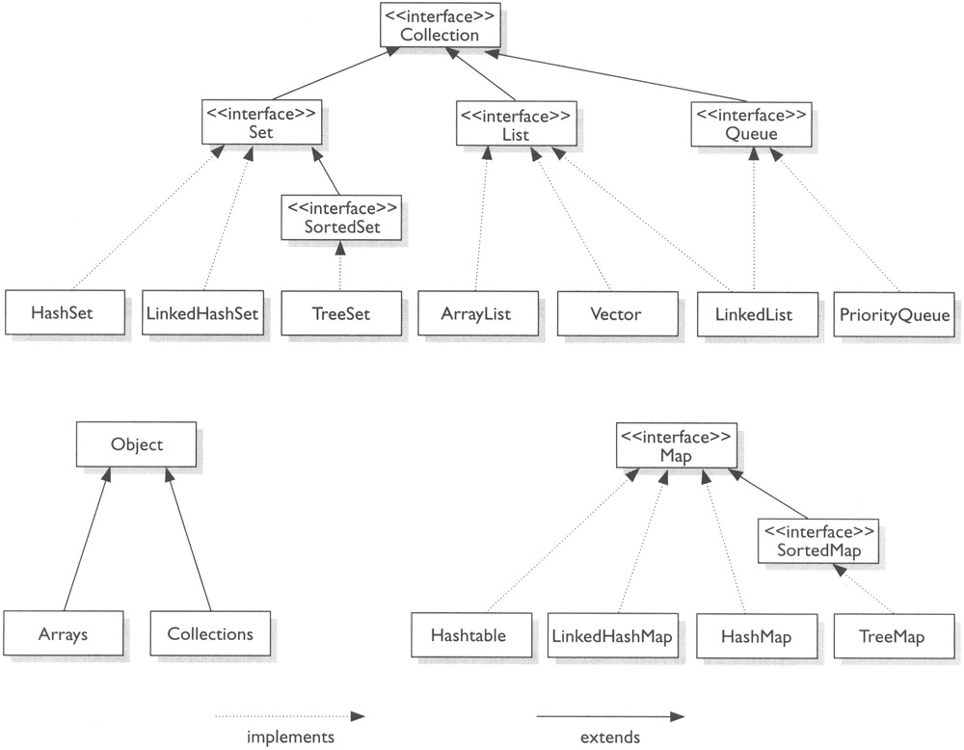

Slide 37
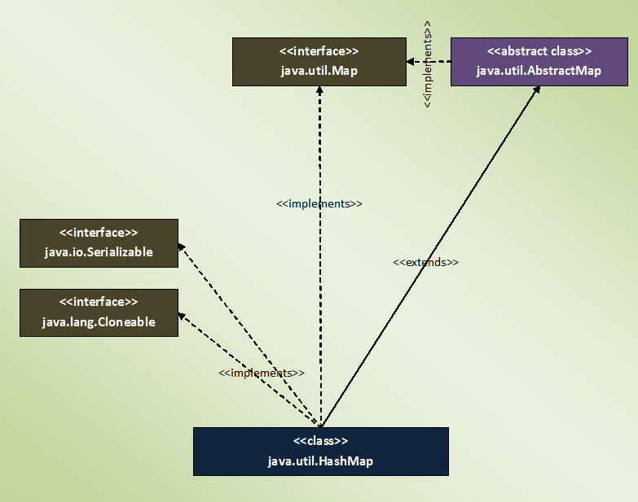

Slide 38
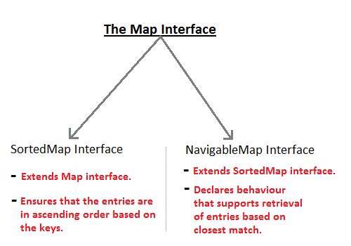

Slide 39
Difference between “collection" ,"Collection" and "Collections"
In the java.util package we going to use these three keywords so what is the difference between these keywords. 1) collection 2) Collection 3) Collections.
collection: It is word represent the Collection Object and Map object.
Collection: It is the super Interface of all Collection i.e. in The Array Format.
Collection is an interface .
Collections: It is class , that contain the Utility methods to operate Collection Object.
Collections is a utility class , which has specific methods to work with collections.

Slide 40
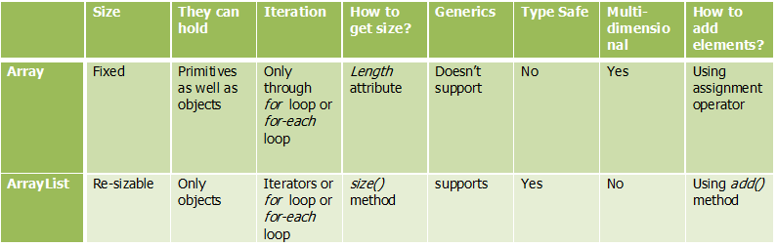

Slide 41
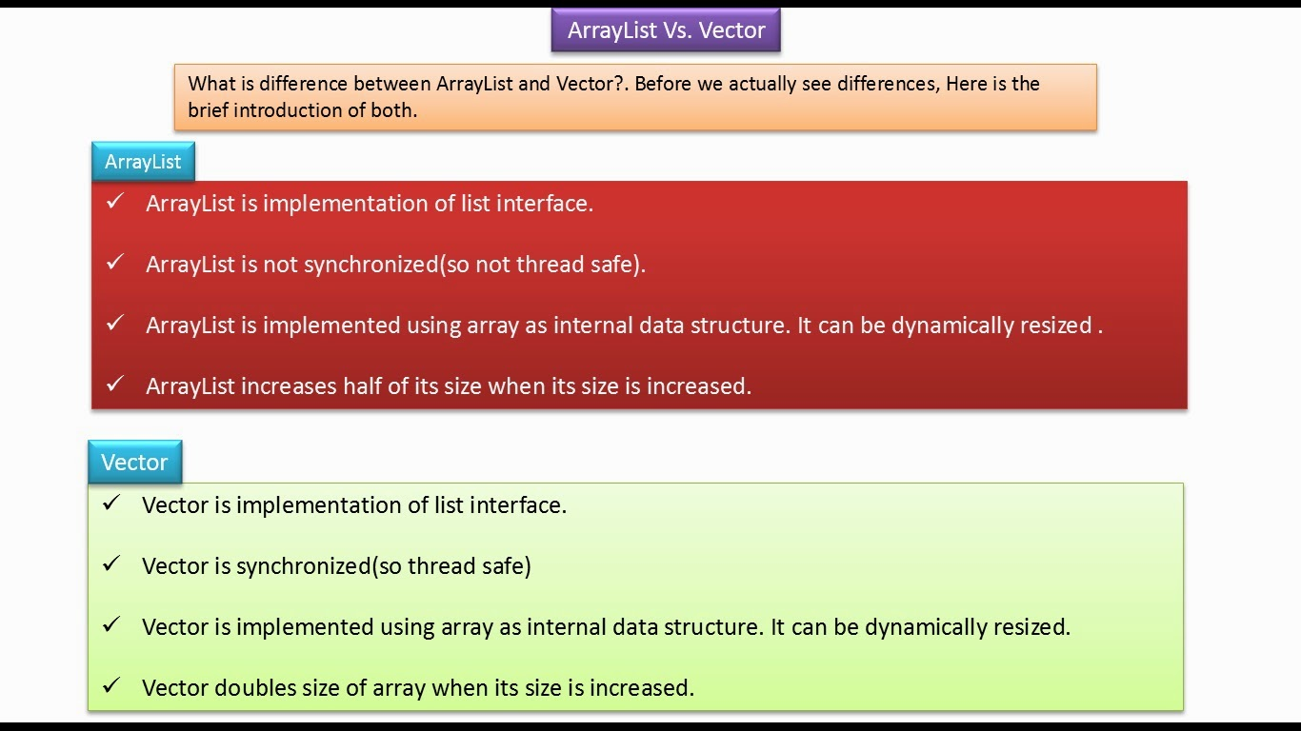

Slide 42
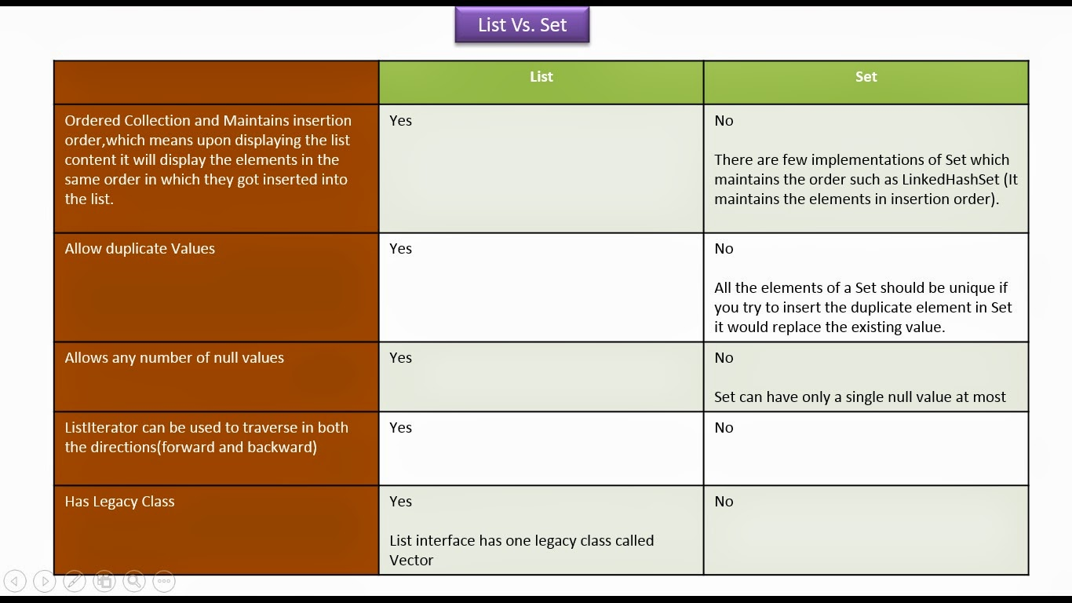

Slide 43
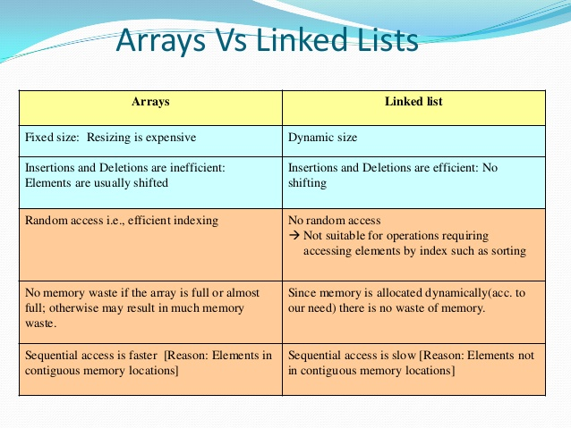

Slide 44
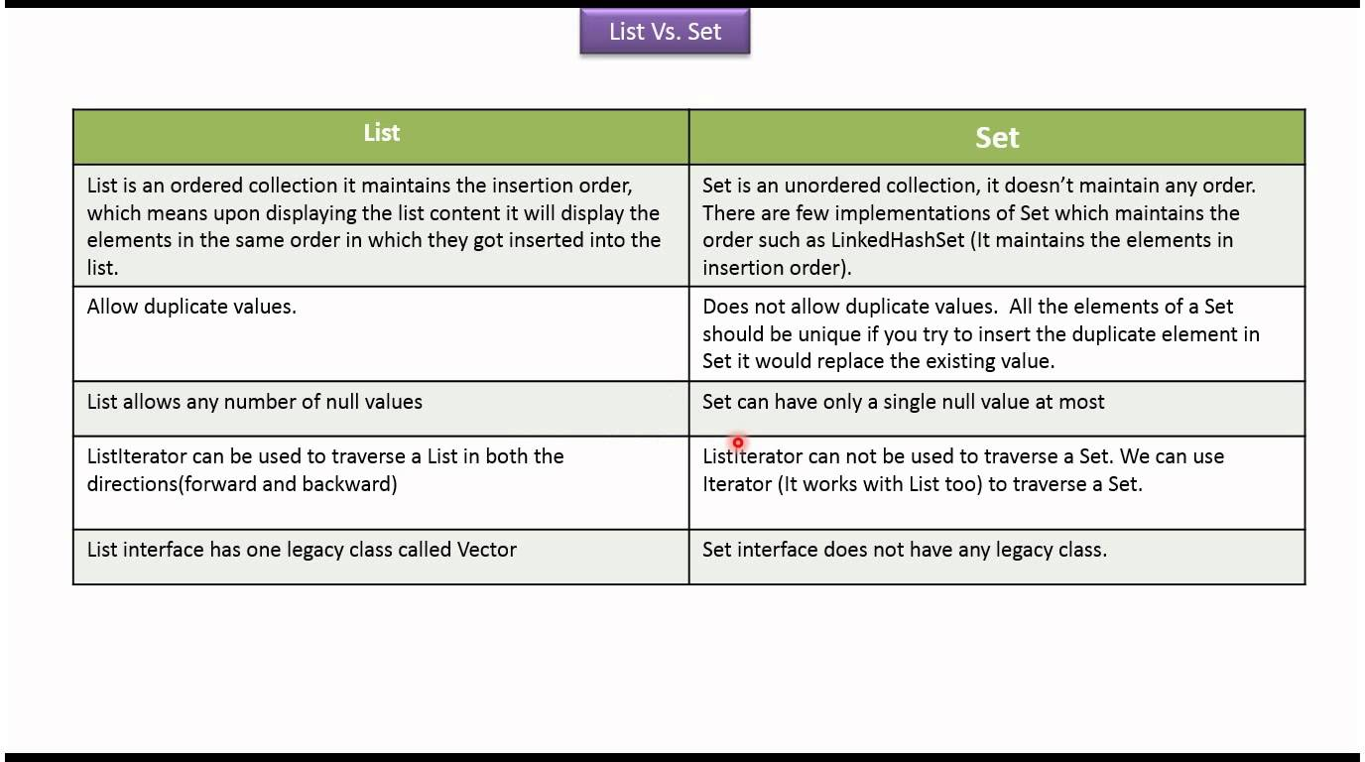

Slide 45
